Slide 1



MICRO CREDIT DEFAULTERS MODEL
BY
V SAMYUKTA

Slide 2
CONTENT
Overview.
Problem Statement.
Problem Understanding.
What is Micro Credit Defaulters Model?
Importance of Micro Credit Defaulters Model.
Exploratory data analysis.
Visualizations.
Analysis.
Data cleaning steps.
Model Building.
Hyper Parameter Tunning.
Saving the model and predictions from saved best model.
Conclusion.

Slide 3
PROBLEM STATEMENT:
Microfinance Institutions (MFIs) are businesses that provide financial services to low-income people. When addressing unbanked poor families living in rural places with few sources of income, MFS becomes quite effective. Group Loans, Agricultural Loans, Individual Business Loans, and other Microfinance Services (MFS) are some of the Microfinance Services (MFS) provided by MFI. Many microfinance institutions (MFI), experts, and donors support the idea of using mobile financial services (MFS), which they believe are more convenient, efficient, and cost-effective than the traditional high-touch model that has been used for many years to deliver microfinance services. Though the MFI industry is primarily focused on low-income families and is extremely beneficial in these areas, MFS implementation has been uneven, with significant challenges and successes. Microfinance is now widely accepted as a tool for poverty reduction, with $70 billion in outstanding loans and a global client base of 200 million people. We are now working with a client in the telecom industry. They are a provider of fixed wireless telecommunications networks. They've released a number of products and built their business and organization around the budget operator model, which entails providing better products at lower prices to all value conscious clients via a disruptive innovation strategy that focuses on the subscriber. They've teamed up with a microfinance institution to offer micro-credit on mobile balances that must be paid back in five days. If the Consumer deviates from the course of repaying the loaned amount within the time period of 5 days, he is considered a defaulter. The payback amount for a loan of 5 (in Indonesian Rupiah) should be 6 (in Indonesian Rupiah), whereas the payback amount for a loan of 10 (in Indonesian Rupiah) should be 12. (in Indonesian Rupiah). Build a model that can be used to predict if a client will pay back the lent amount within 5 days of loan insurance in terms of a probability for each loan transaction. Label '1' shows that the loan has been paid, indicating that it is a non-defaulter, whereas Label '0' indicates that the loan has not been paid, indicating that it is a defaulter.

Slide 4
PROBLEM UNDERSTANDING:
Micro Credit is a technology and service package given in collaboration with telecom providers at the final stage of product delivery. Some of the significant features of microfinance are as follows: 1. The borrowers are generally from low-income backgrounds 2. Loans availed under microfinance are usually of small amount, i.e., micr0 loans 3. The loan tenure is short 4. Microfinance loans do not require any collateral 5. These loans are usually repaid at higher frequencies 6. The purpose of most microfinance loans is income generation

Slide 5
What is Micro Credit Defaulters Model?
With the rapid growth of technology and increased competition, telecom firms are looking for ways to improve the quality of their service and, as a result, the health of their revenue. Miniature credit arrangement furnishes administrators and specialist organizations with the capacity to stretch out their support of their clients through a little, transient credit office. At the point when we go through the dataset given, we should look at deliberately every one of the characteristics given, arrange the clients between defaulters and non-defaulters, and lessen the possibility of deceitfulness in miniature credit advances by clients.

Slide 6
IMPORTANCE OF MICRO CREDIT DEFAULTERS MODEL
Microcredit is a common form of microfinance that involves an extremely small loan given to an individual to help them become self-employed or grow a small business.
Today, microfinance is widely accepted as a poverty-reduction tool, representing $70 billion in outstanding loans and a global outreach of 200 million clients.
Micro credit solution provides operators and service providers with the ability to extend their service to their users through a small, short term credit facility. When we go through the dataset provided, we are supposed to examine methodically all the attributes provided, classify the customers between defaulters and non-defaulters and reduce the chances of fraudulence micro credit loan by users.

Slide 7
EXPLORATORY DATA ANALYSIS:
I have imported required libraries and I have imported the dataset which was in csv format.
Then I did all the statistical analysis like checking shape, nunique, value counts, info etc.
I have also dropped few column as I found those columns contain more than 90% of its values are equal to 0.
Next as a part of feature extraction I converted the data type of target column in to object type from int type as this is a classification problem and target columns is having categorical values

Slide 8
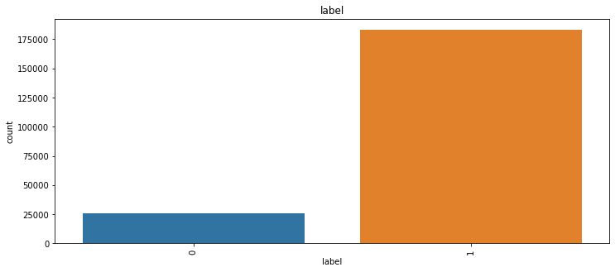
VISUALIZATION OF CATEGORICAL COLUMNS:

Slide 9
OBSERVATIONS:
There are 87.5% of non-defaulters and 12.5% of defaulter customers, the data is unbalanced we will use random oversampling technique to balance the target.

Slide 10
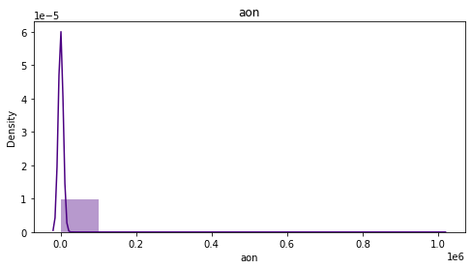
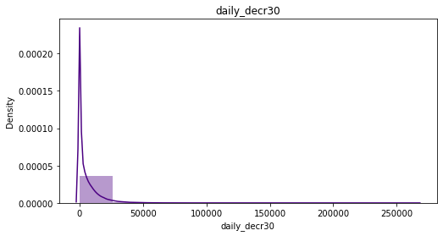
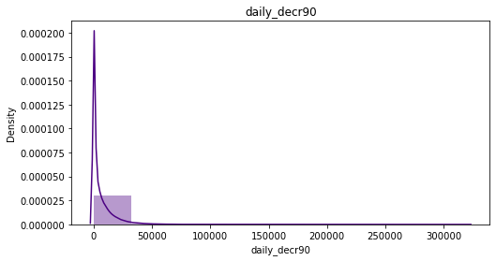
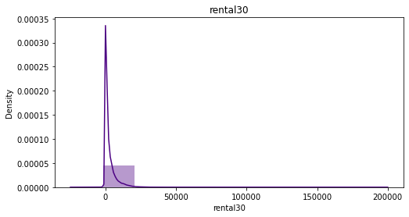
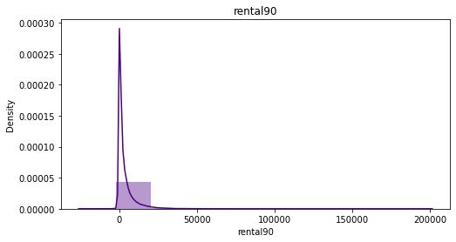
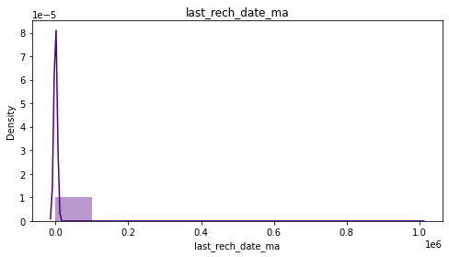
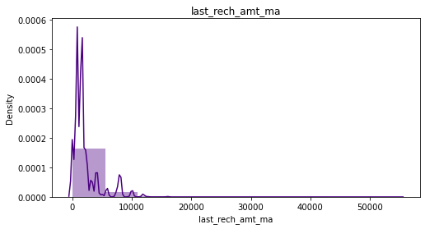
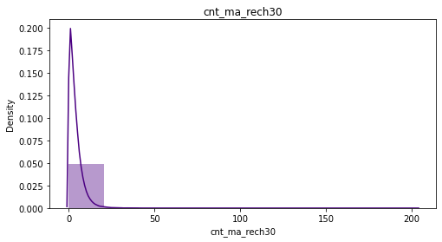
VIZUALIZATION OF NUMIRICALCAL COLUMNS:

Slide 11
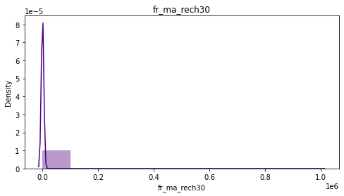
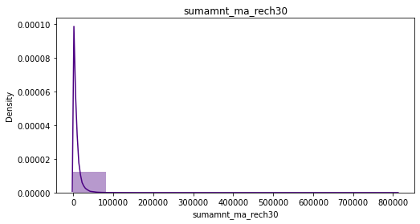
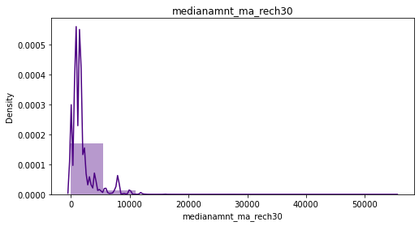
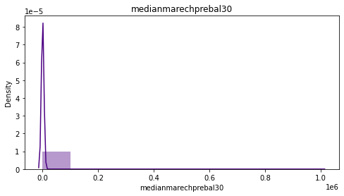
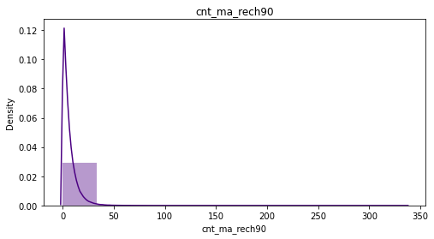
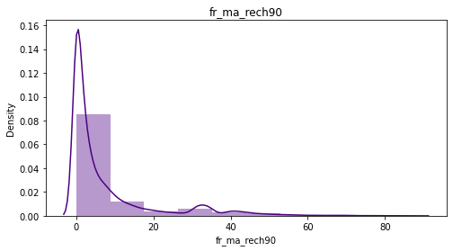
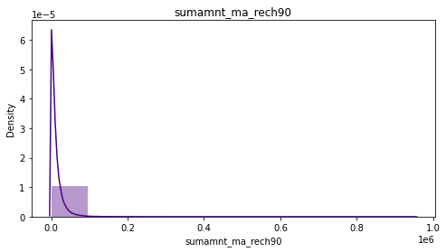
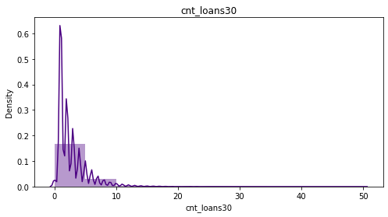
VIZUALIZATION OF NUMIRICALCAL COLUMNS:

Slide 12
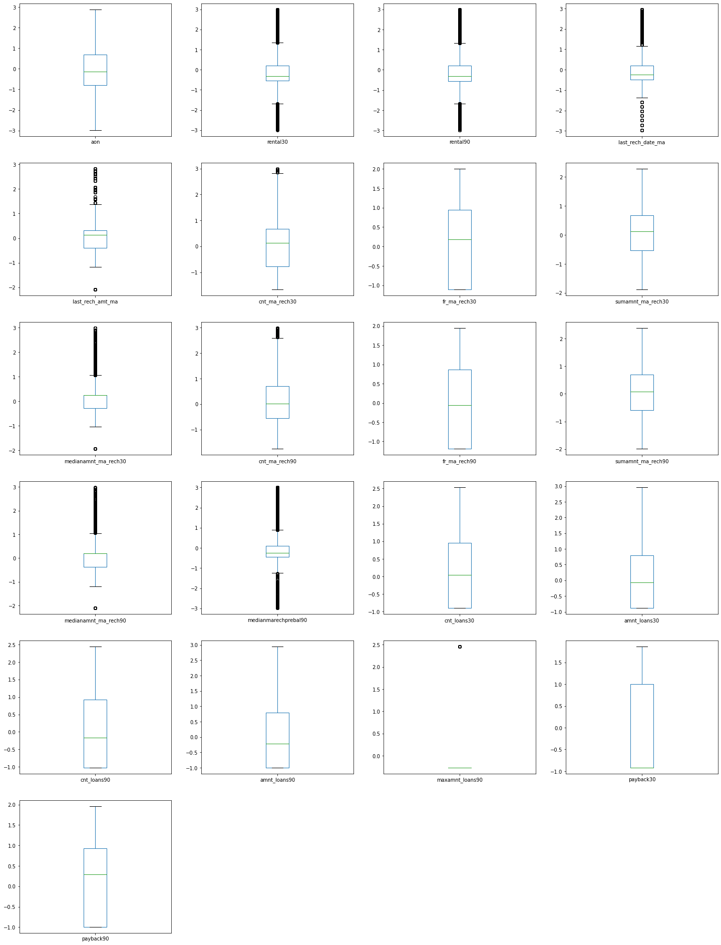
VIZUALIZATION OF NUMIRICALCAL COLUMNS:

Slide 13
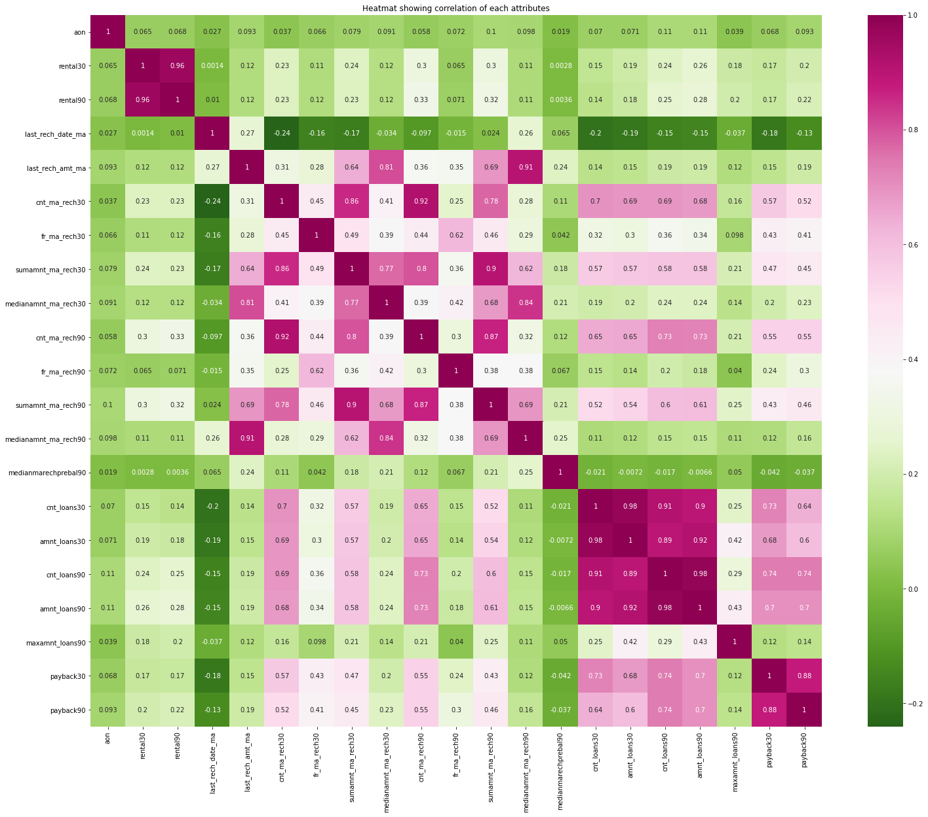
VIZUALIZATION OF NUMIRICALCAL COLUMNS:

Slide 14
OBSERVATIONS:
Skewness is present in all the columns.
Data in all the columns are widely spread.
In most of the column’s data is concentrated at some particular values.
In most of the column’s outliers are present.
There are many multicollinearity issues in the dataset.
amnt_loans90,cnt_loans90,amnt_loans30,sumamnt_ma_rech30 columns have high multicollinearity issues.
We can understand that these values have less importance towards the model inference. Let us proceed by dropping these columns from the dataset.

Slide 15
ANALYSIS:
To tackle the problem, I employed both statistical and analytical methodologies, which mostly included data pre-processing and EDA to examine the connection of independent and dependent characteristics. In addition, before feeding the input data into the machine learning models, I made sure that it was cleaned and scaled.
We need to anticipate micro credit defaulters for this project, our target column is a categorical data. Which makes this project as classification challenge. I evaluated the prediction using a variety of classification methods. After a series of assessments, I determined that Extra Trees classifier is the best method for our final model since it has the best r2-score and the smallest difference in r2-score and CV-score of all the algorithms tested
I used K-Fold cross validation to gain high performance and accuracy. Then hyper parameter tweaked the final model.
Once I had my desired final model, I made sure to save it before loading the testing data.

Slide 16
DATA CLEANING STEPS:
Datasets I found there is no null values,
Dataset has many outliers and skewness is also present.
VIF method was used to check the correlation between columns.
Also I have used standardization. Then followed by model building with all classification algorithms.

Slide 17
MODEL BUILDING:
To feed the dataset to the model, the independent and dependent variables are to be split and the independent attributes are standardized using ‘StandardScaler’ library. Now the data obtained is clean and is having least multicollinearity, independent and balanced data. ‘train_test_split’ function in model selection is used for splitting data arrays into two subsets: for training data and for testing data. We train the model using the training set and then apply the model to the test set. I have chosen 5 classification machine learning algorithms which is suitable for the pre-processed and cleaned data to train and test the dataset.
RandomForestClassifier
ExtraTreeClassifier
GradientBoostingClassifier
SupportVectorClassifier

Slide 18
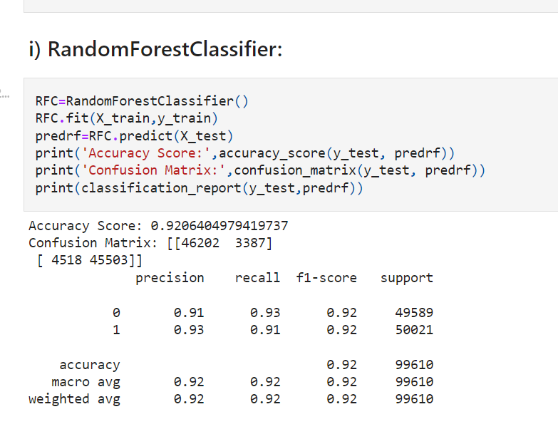
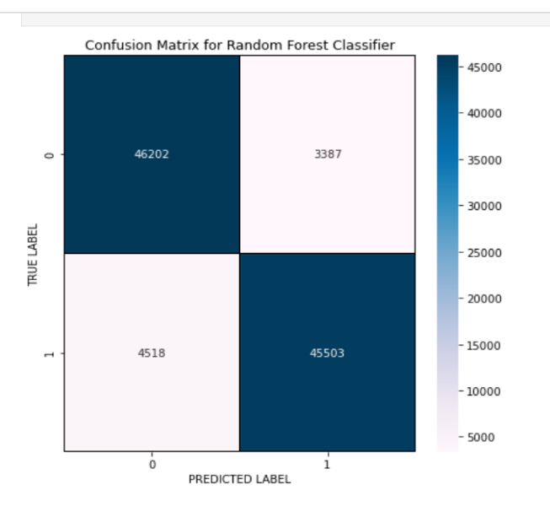
I) RANDOM FOREST CLASSIFIER:

Slide 19
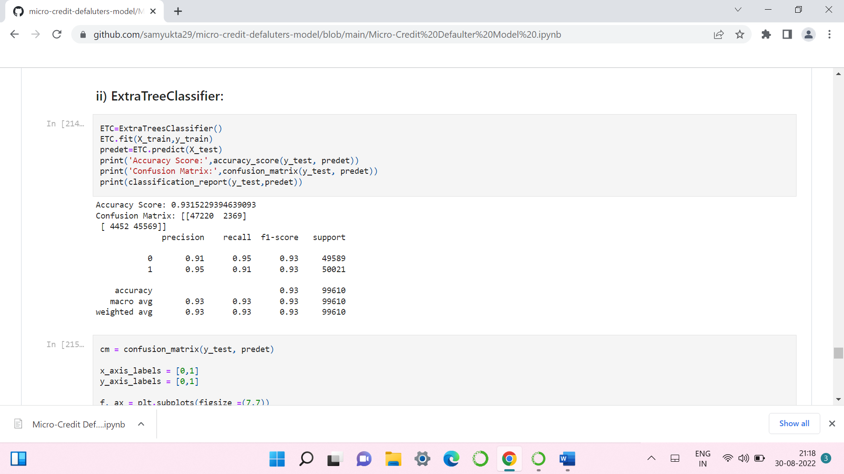
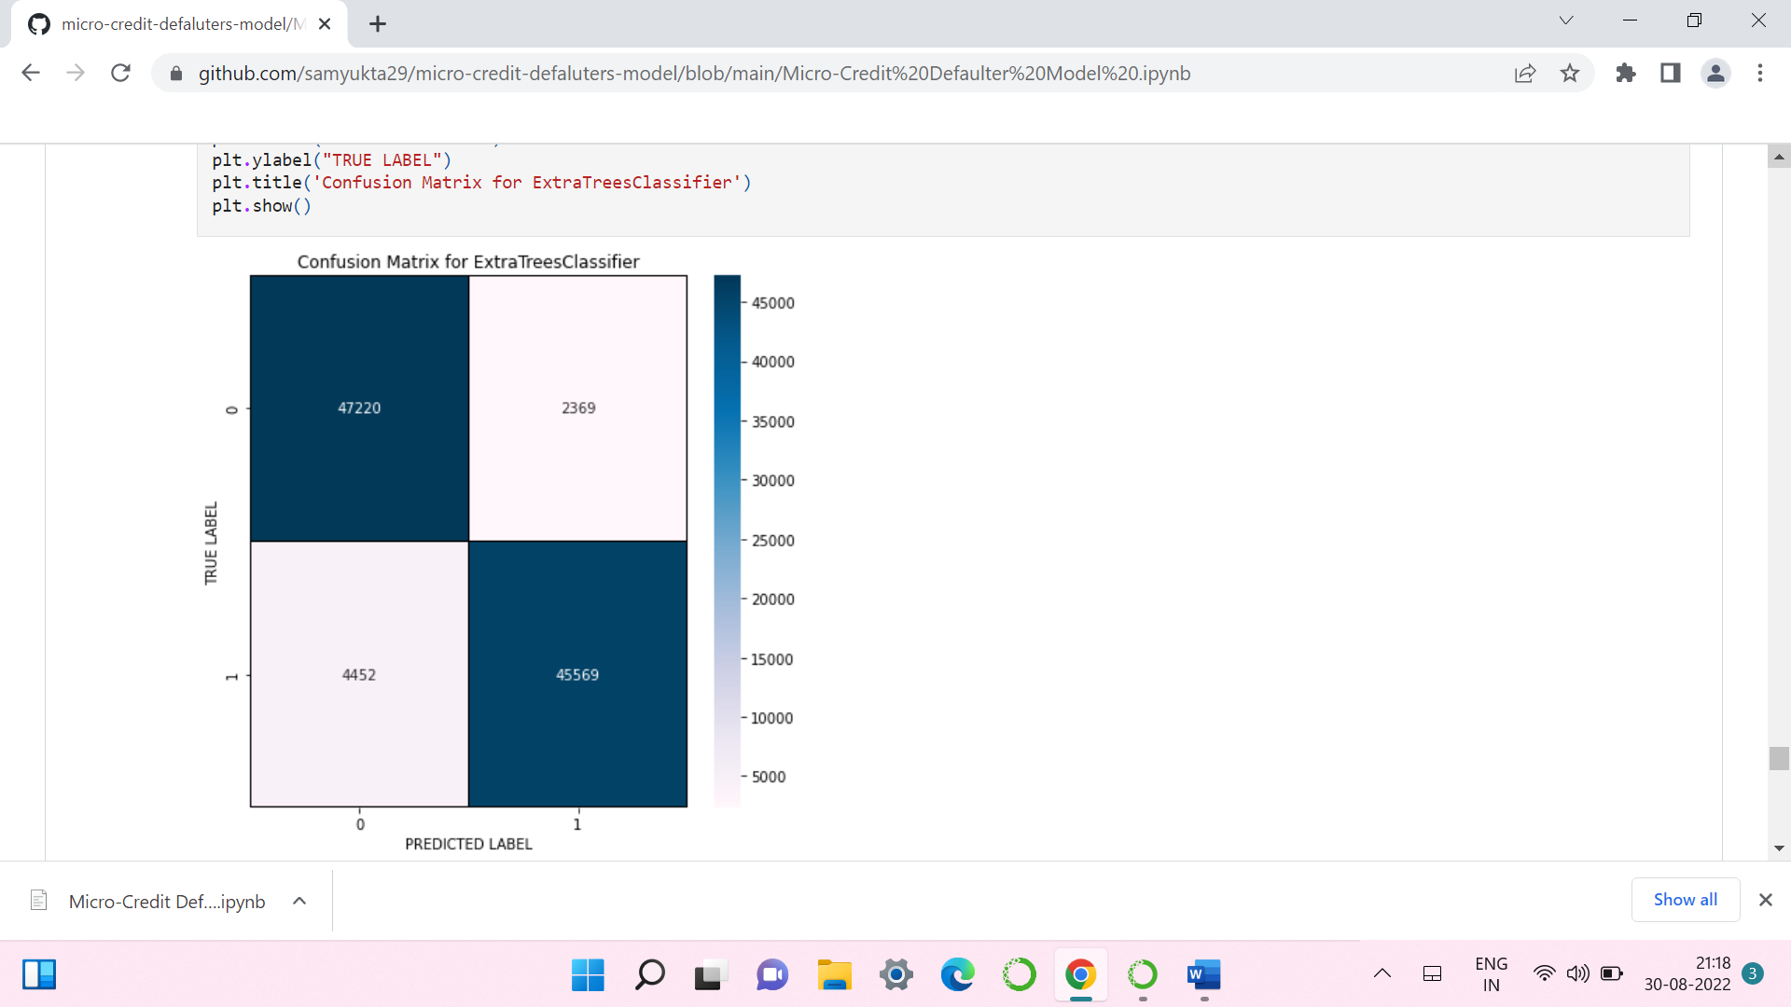
II)EXTRA TREE CLASSIFIER:

Slide 20

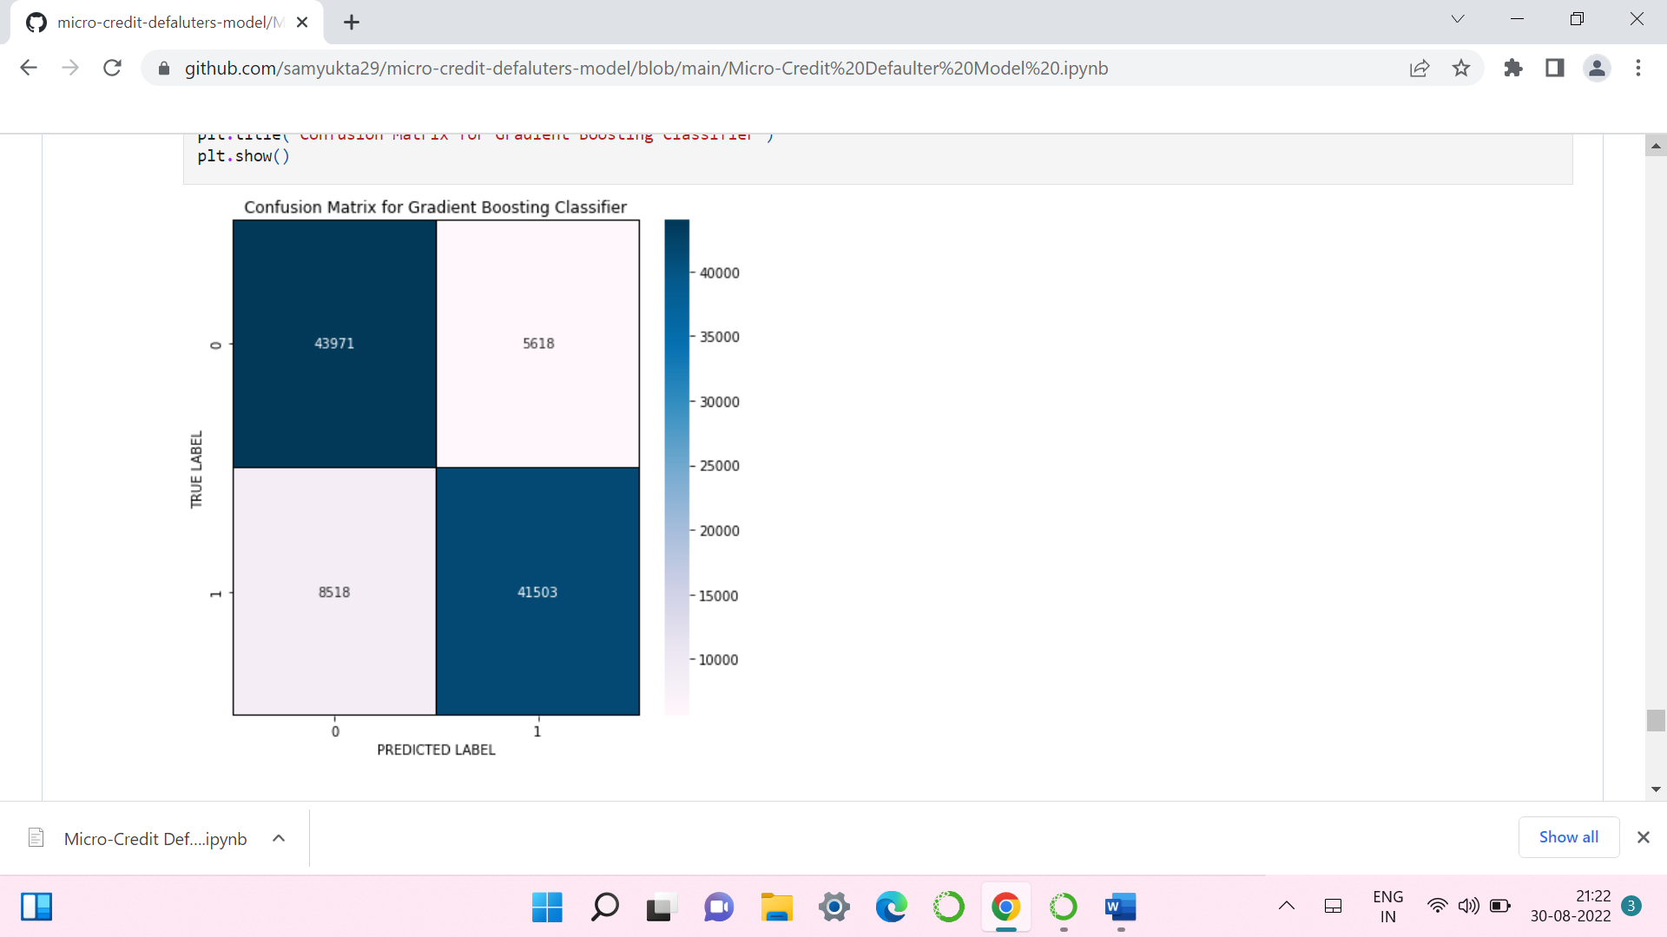
III) GRADIENT BOOSTING CLASSIFIER:

Slide 21
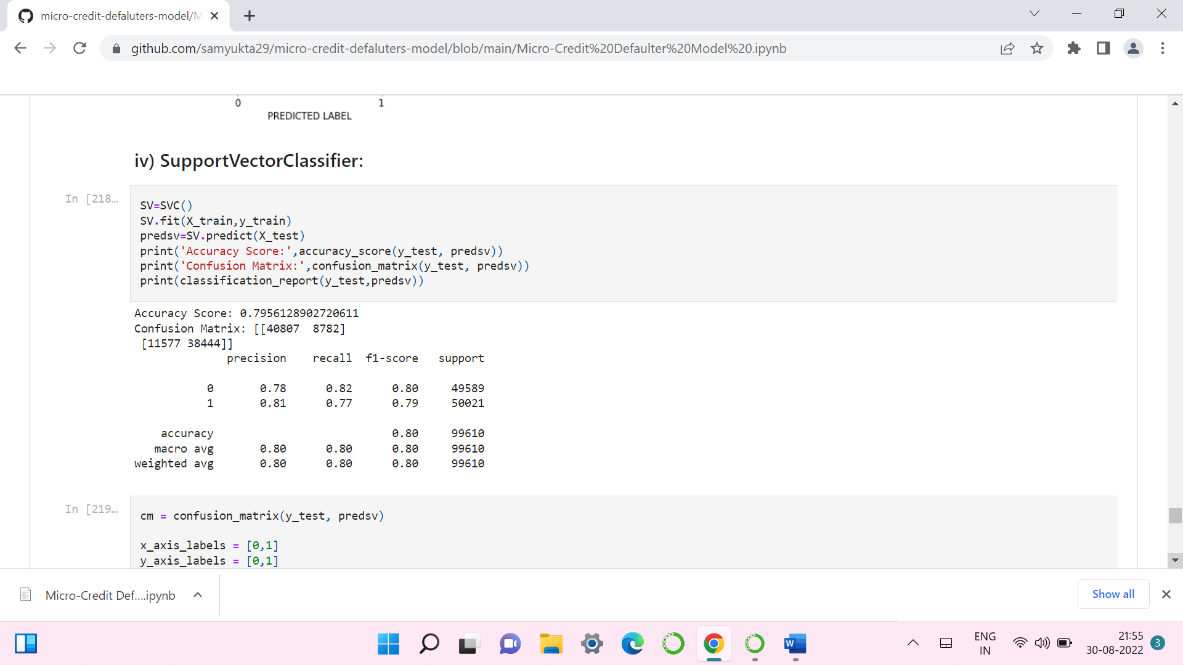
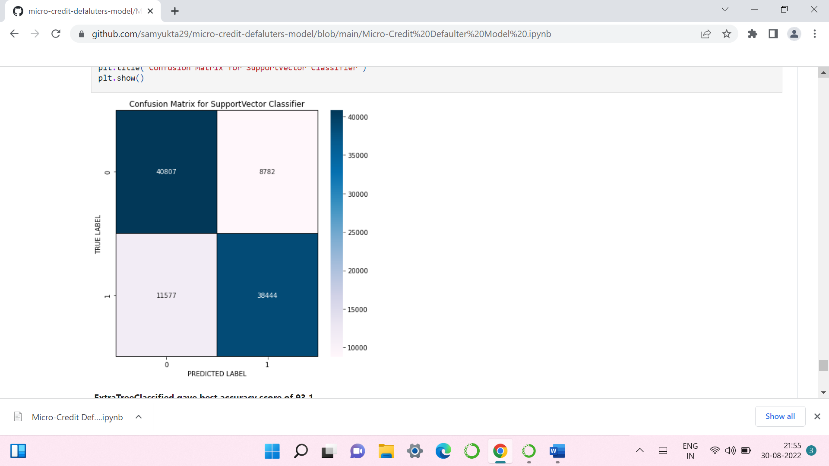
IV) SUPPORT VECTOR CLASSIFIER:

Slide 22
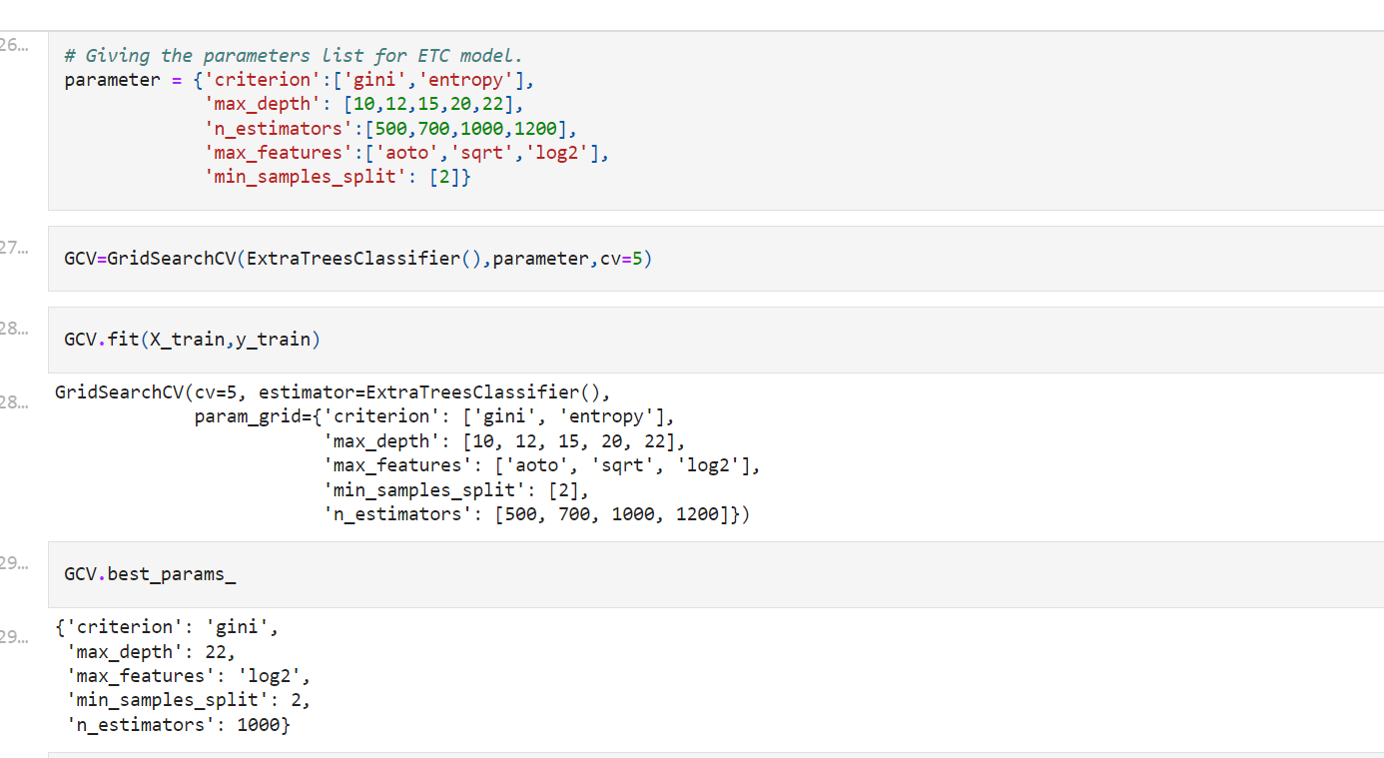
HYPER PARAMETER TUNNING:

Slide 23
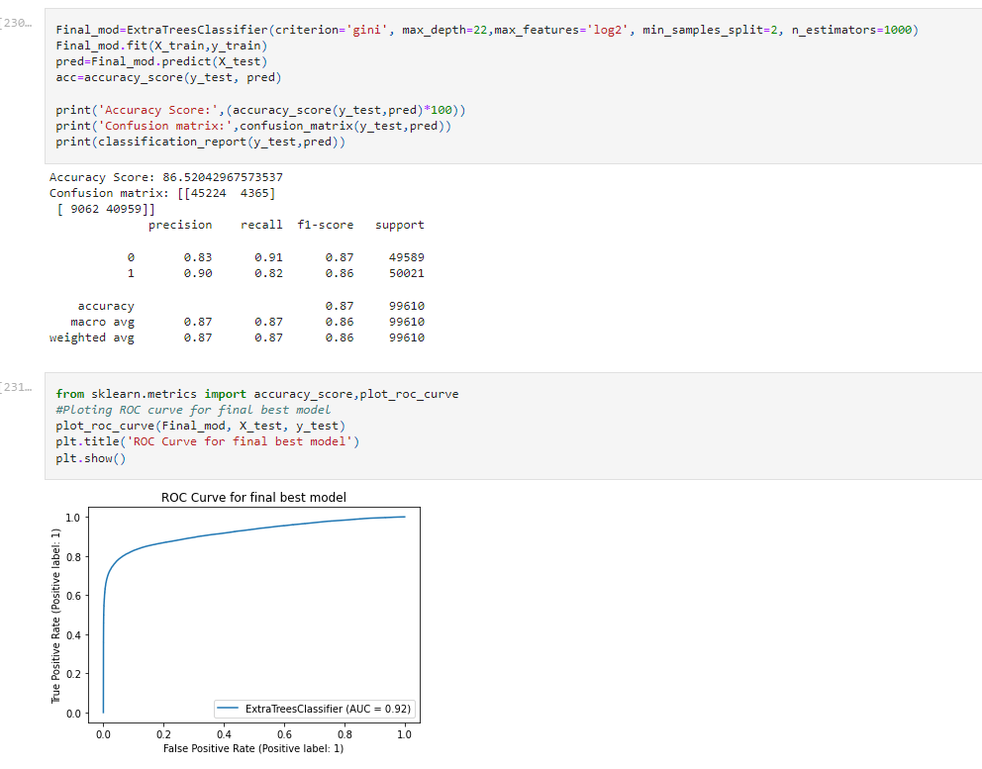
HYPER PARAMETER TUNNING:
I have chosen all parameters of ExtraTreesClassifier, after tunning the model with best parameters model accuracy is 92%.

Slide 24
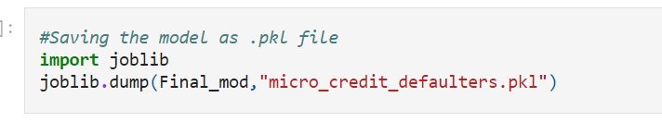
SAVING THE MODEL AND PREDICTIONS USING SAVED MODEL:
I have saved my best model using .pkl as follows.
Now after saving the best model, loading my saved model and predicting the test values.

Slide 25
CONCLUSION:
1) Around 28% users are highly defaulters with a mostly negative or null balance.
2) Users with high equilibrium and a much lower number are defaulter.
3) Nonstandard loans (i.e. 98 percent of the category) are paid to users who take up more loans as they pay back the loan within 5 days.
4) 10% to 12% of users are defaulters in the Average and Low Balance categories.
5) Non-defaulting users who have taken no loans.
6) Around 97% users are taking large loans which fall into non-default categories.
7) Defaulters include 40 percent of the users that do not have a single recharge in 3 months.
8) Around 14 percent of users fall into the category of defaulting loans, on average.
9) The default is only 40% of users who do not reload in 90 days.
10) Users who recharge very high pay their loans on time. That is, 98% of them are non-defaulting ones.
11) defaulting is 34 percent of users who reload less.
12) Old and largely non default users are trusted
13) 17% of users receiving small loans are non-performing.
14) The new users constitute 32% of the users defaulting.
15) Of users who recharge and pay their loans on time, 99 percent are more in number, which is good news for the company than for any other category.

Slide 26


